Slide 1
Effect of alcohol control policy on population-level behaviour and health outcomes
Alexander Tran, PhD

Slide 2





My academic history:
BSc. Kinesiology (2007-2011) McMaster University
(minor in psychology)
MSc. Kinesiology (2011-2013)
(health psychology)
Psychology PhD (2013-2018) York University University of Waterloo
Social Neuroscience PDF (2018-2019 University of Alberta
Epidemiological Researcher (2020 – 2024) Centre for Addiction and Mental Health

Slide 3
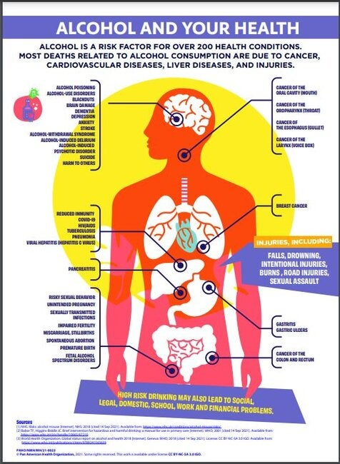
Alcohol use is a problem
Increased risk of cardiovascular disease, liver disease, and cancer (Rehm et al., 2017)
Significant public health risk, consumption is among the highest in the European region (World Health Organization, 2018; Vos et al., 2020)

Slide 4
Alcohol use is a problem
Alcohol is the second most used psychoactive substance next to cannabis
Canada has X% of all mortality linked to alcohol

Slide 5
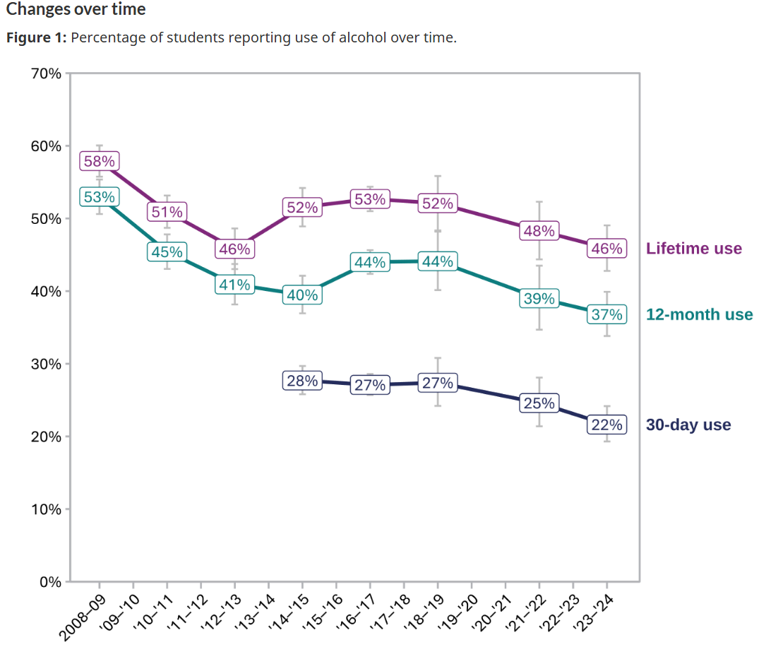
Statistics Canada (2024). https://www.canada.ca/en/health-canada/services/canadian-student-tobacco-alcohol-drugs-survey/2023-2024-key-findings.html

Slide 6
Evidence that problematic alcohol use remains a problem (elevated since 2000s)
Problem in Canada and US, and across age groups, some slowing in recent years

Slide 7
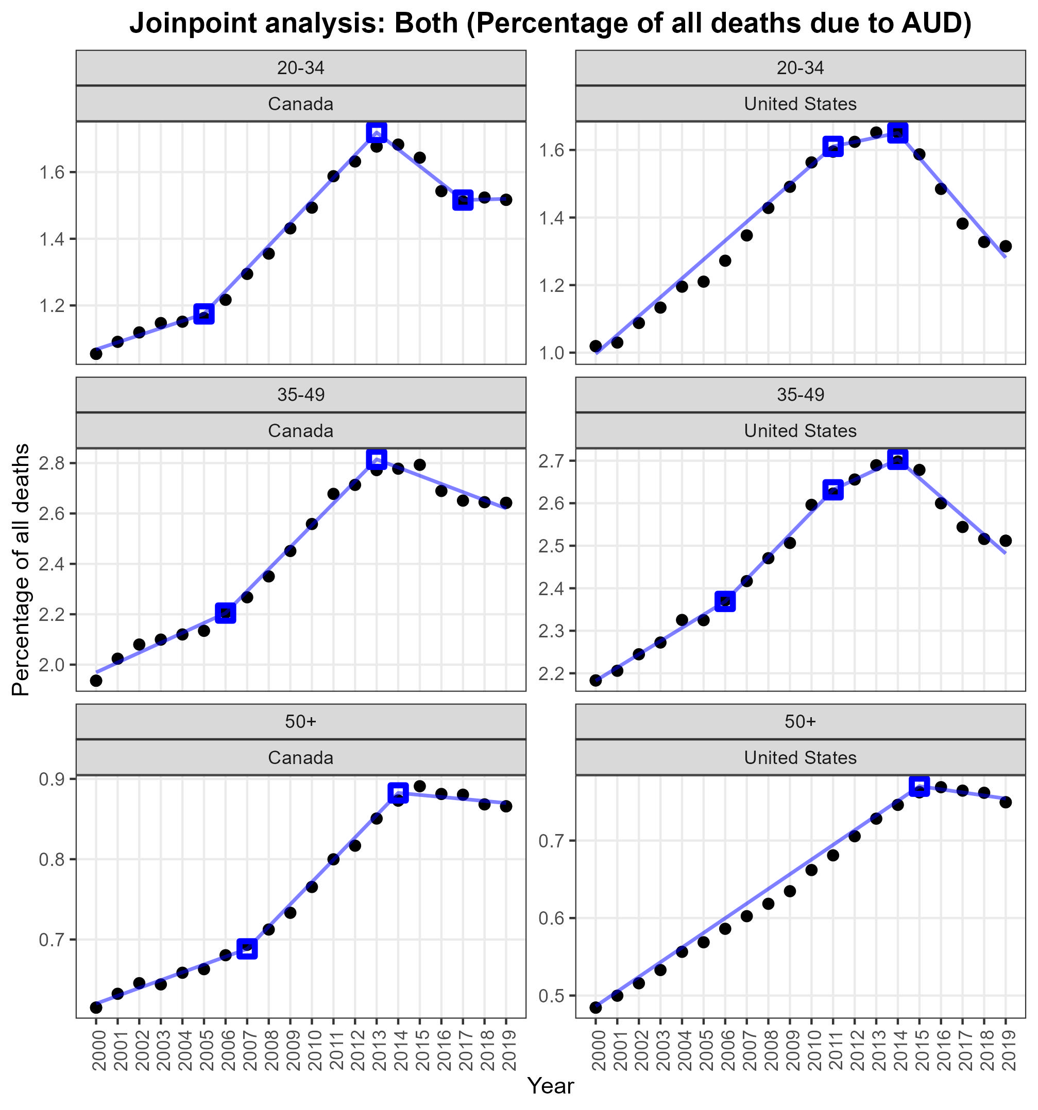
Tran, A., Jiang, H., Lange, S., & Rehm, J. (2024). Trend of alcohol use disorder as a percentage of all-cause mortality in North America. BMC Research Notes, 17(1), 237.

Slide 8
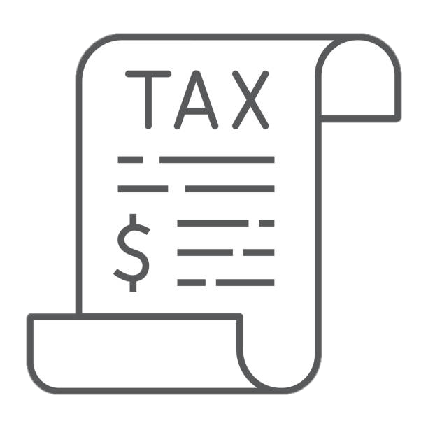
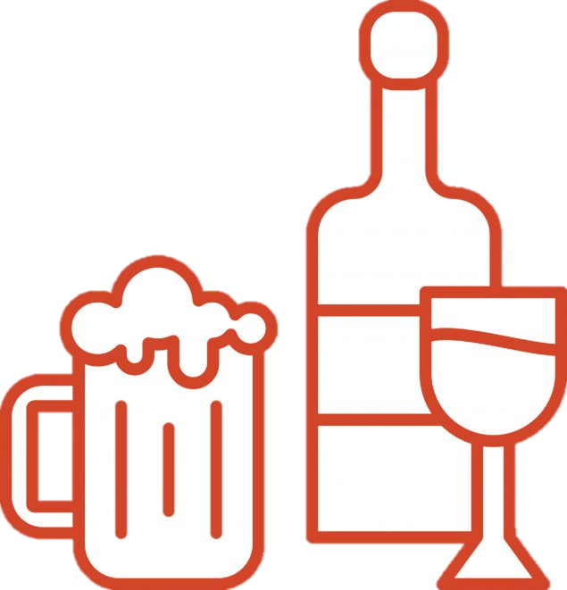

Policy changes and alcohol-related harm
Alcohol consumption and harm can be reduced through public policy (Babor et al., 2010; Stockwell et al., 2020; Neufeld & Rehm, 2018)
Meanwhile repealing of alcohol control polices is associated with increased alcohol related harms (Andreasson et al., 2006; Room et al., 2013)

Slide 9

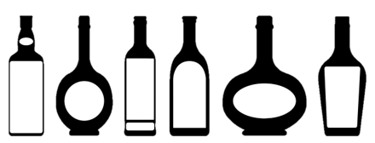

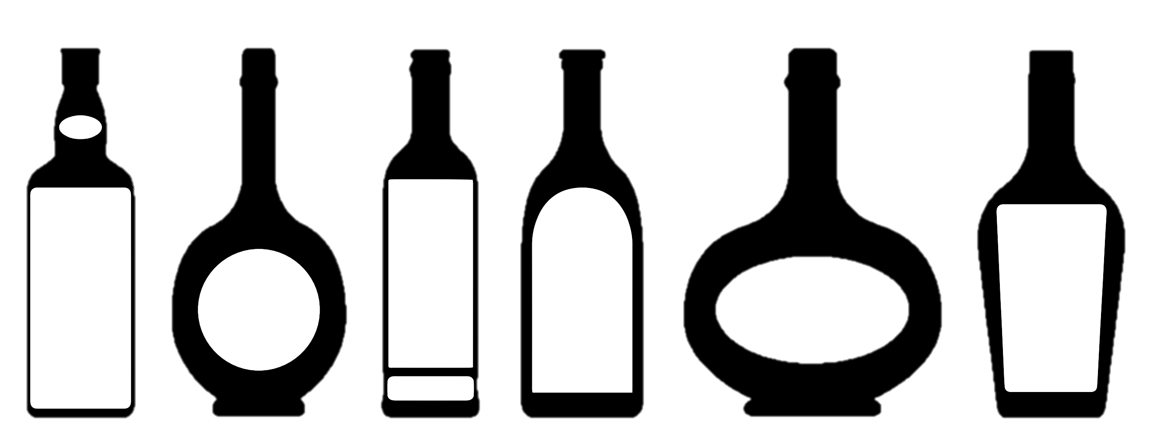
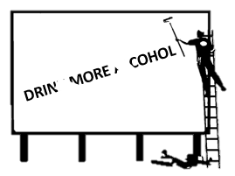
WHO “best buys”
The World Health Organization (WHO) has identified 3 categories of public policy that are effective and cost-effective in reducing alcohol-attributable harm (Chisholm et al., 2018);
Taxation
Decreased availability
Bans on marketing and advertising

Slide 10
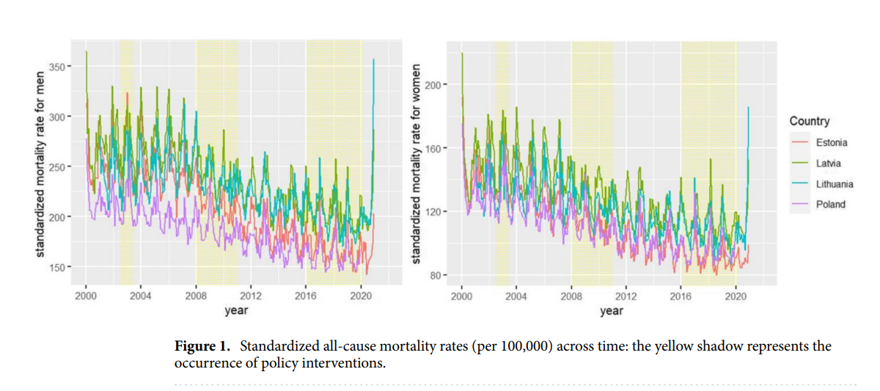
All-cause mortality

Slide 11
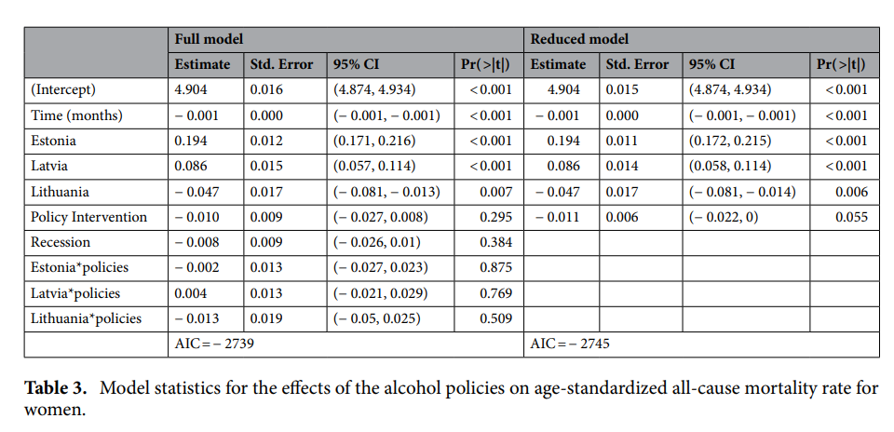

Slide 12
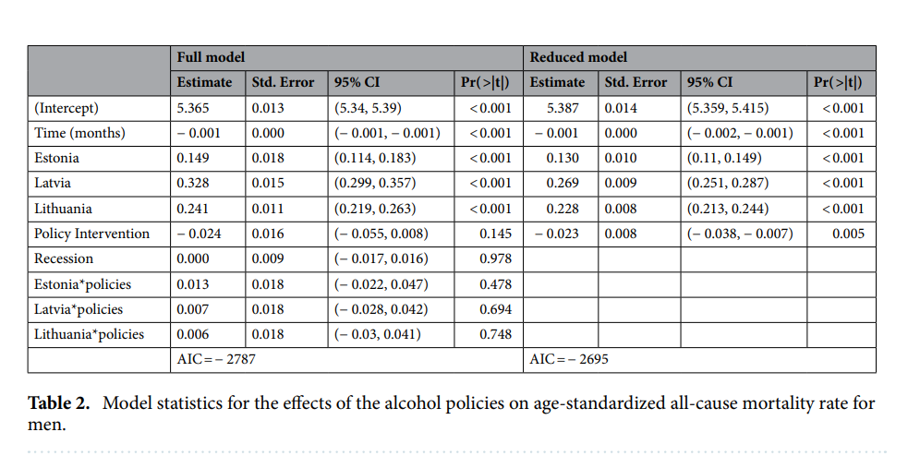

Slide 13
Results: Total per capita consumption
 | Effect | SE | t-value | p-value | Adjusted-R²
Model 1 |  |  |  |  | 0.88
Intercept | 8.04 | 1.44 | 5.78 | p = .001
Linear Time | 0.063 | 0.011 | 5.42 | p = .001
Quadratic Time | -0.00030 | 0.000031 | -9.88 | p = .001
GDP | 0.14 | 0.10 | 1.33 | p = 0.20
CPI (Inflation) | -0.054 | 0.030 | -1.80 | p = .093
Model 2 |  |  |  |  | 0.95
Intercept | 5.30 | 1.15 | 4.60 | p = .001
Linear Time | 0.016 | 0.014 | 1.14 | p = 0.27
Quadratic Time | -0.00017 | 0.000034 | -5.08 | p = .001
GDP | 0.39 | 0.091 | 4.22 | p = 0.0012
CPI (Inflation) | -0.10 | 0.023 | -4.50 | p = .001
Policy 2008 | 1.06 | 0.40 | 2.60 | p = 0.023
Policy 2017 | -1.64 | 0.36 | -4.54 | p = .001
Note: Model 1 (no policy effects) and Model 2 (Policy 2008 and Policy 2017) for total recorded alcohol consumption per capita (individuals 15+ years of age), GDP = gross domestic product, CPI = consumer price index

Slide 14
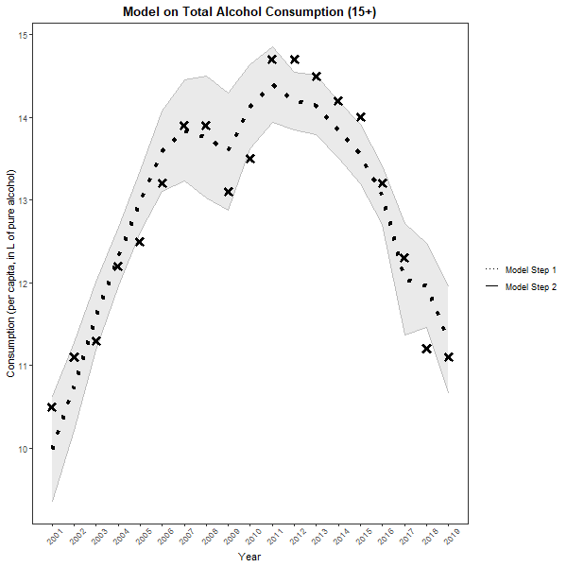
Alcohol consumption

Slide 15
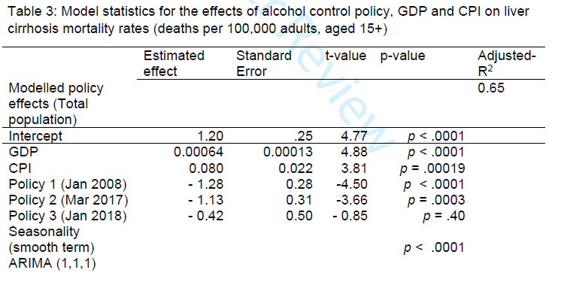
Results: LC deaths

Slide 16
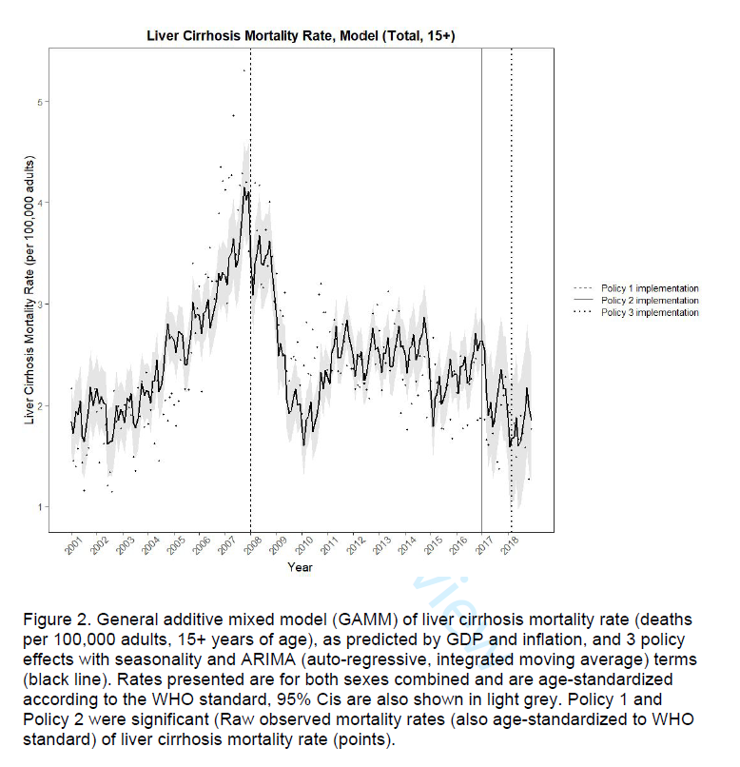
Alcohol-specific deaths

Slide 17
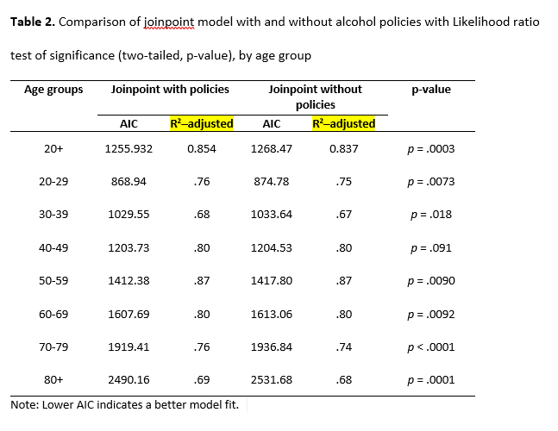

Slide 18
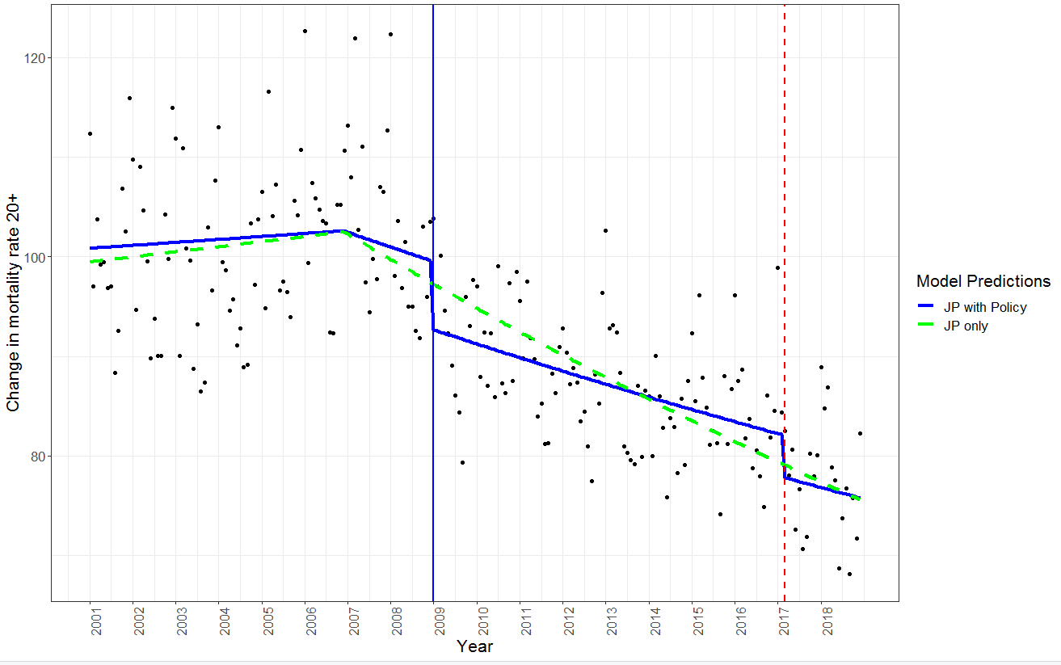

Slide 19
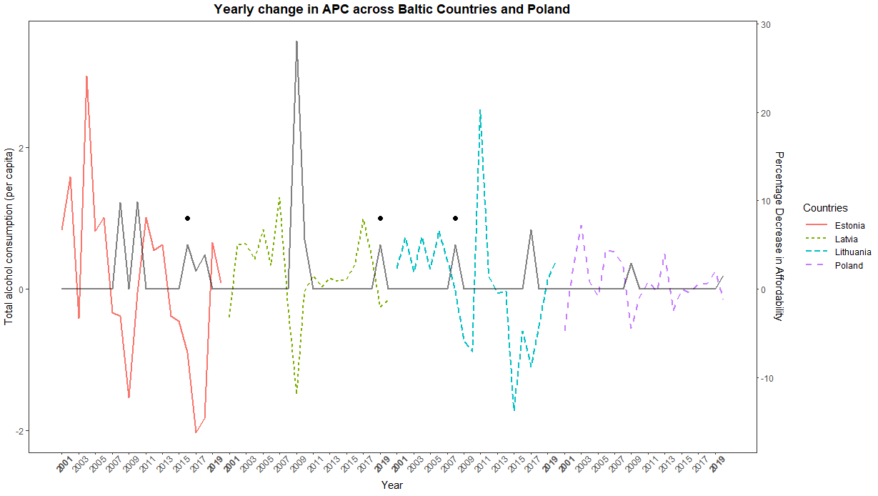

Slide 20
Discussion
Multi-analysis multi-method approach to determine the same result, do alcohol policies work on behaviour?
Consumption
Liver cirrhosis
All cause mortality
Traffic accidents, suicides (not shown here)
Must be rigorous when “n = 1”
Joinpoint regression, GAMM, control countries (other Baltic states), various outcome measures
Not shown, growth curve analysis, synthetic control method, agent-based modelling, micro simulation
Probst, C., Buckley, C., Lasserre, A. M., Kerr, W. C., Mulia, N., Puka, K., ... & Rehm, J. (2023). Simulation of Alcohol Control Policies for Health Equity (SIMAH) project: study design and first results. American journal of epidemiology, 192(5), 690-702.
Probst, C., Vu, T. M., Epstein, J. M., Nielsen, A. E., Buckley, C., Brennan, A., ... & Purshouse, R. C. (2020). The normative underpinnings of population-level alcohol use: An individual-level simulation model. Health Education & Behavior, 47(2), 224-234.

Slide 21
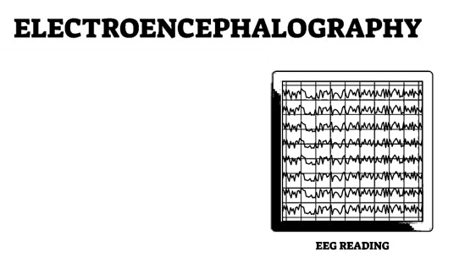
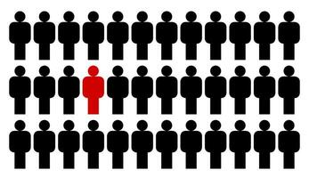
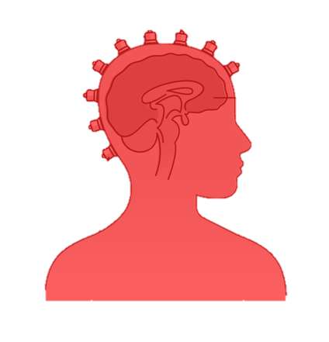
Psychology, Neuroscience and Behaviour
Predictive validity of individuals “makes up” public health
Psychological theories, research/experiments should have a synergistic effect with population research

Slide 22
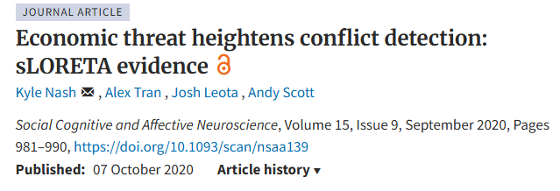
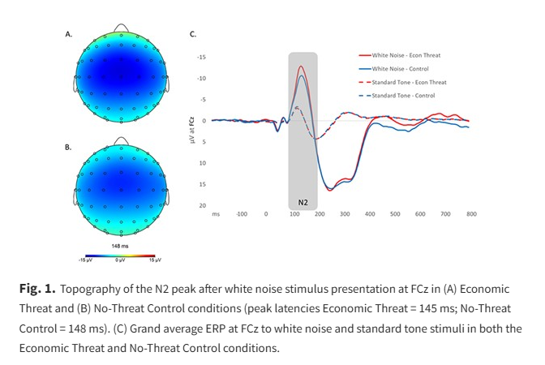
Social Neuroscience
Experience using neurophysiology to explore social psychological questions
But does it really extend to the real world–external validity?

Slide 23
Population health (epidemiology) and public policy
Studying behaviour at a massive scale
Randomization can eliminate baseline differences, but big data allows us to analyze it (moderator effects, 3-to-4-way interactions)
Not just the effect and the outcome, but what it means

Slide 24
Questions?

